Slide 1
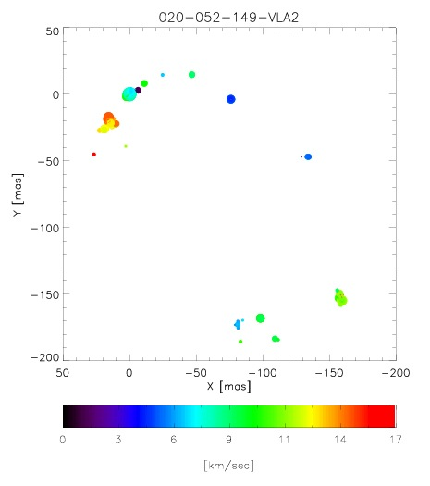
Transition in the Outflow Evolution of the Massive Star-forming Region W75N
2014 October 9, EVN Symposium
Jeong-Sook Kim
National Astronomical Observatory of Japan (NAOJ)

Slide 2
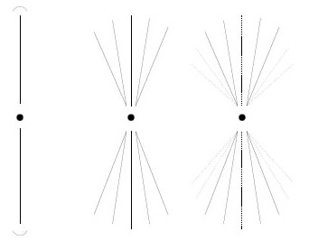
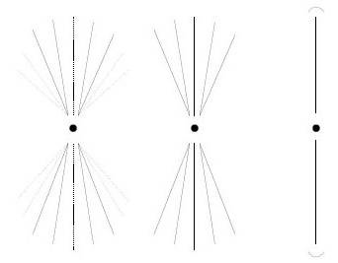
Massive Star Formation & Outflow Evolution
The evolution of outflow associated with massive star formation is still in debate, that is,
In Scenario 1: [star formation through accretion disk]
the well-collimated outflow occur first before the less collimated outflow forms with the build-up of HII region (Beuther et al. 2005)
Scenario 2: [gas ejection vis MHD]:
However, in recent MHD simulations, wind-like outflow could occur first depending on magnetic filed strength. (Seifried et al. 2011, 2012)

Slide 3
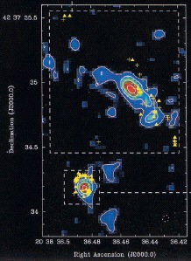
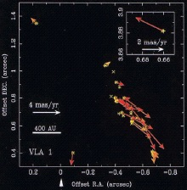
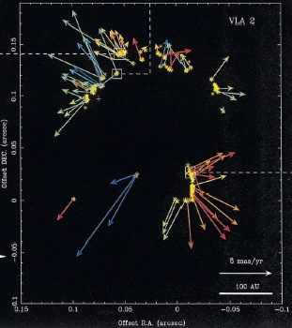
Distribution of H2O Maser in W75N -1999 (VLBA)
(Torrelles et al. 2003)
In VLA1, the maser distribution is a well collimated jet like outflow.
In VLA2, the maser shell with 130 AU shows a less-collimated and wind-like outflow.
VLA1
VLA2

Slide 4
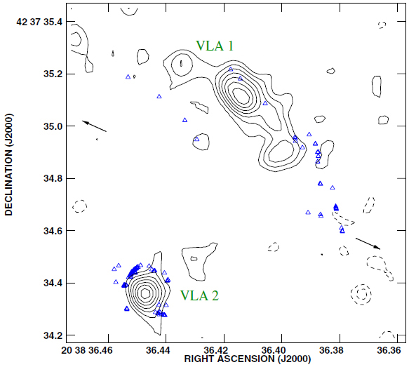
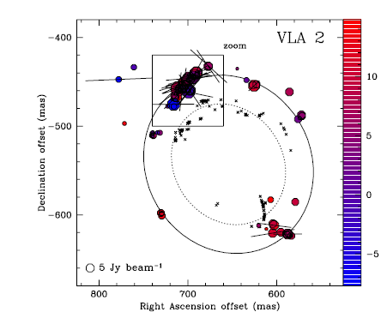
Distribution of H2O Maser in W75N - 2005(VLBA)
Surcis et al. (2011)
VLA1
VLA2
Six years later, Surcis et al. (2011) found that the wind-like outflow in VLA 2 is still expanding.

Slide 5
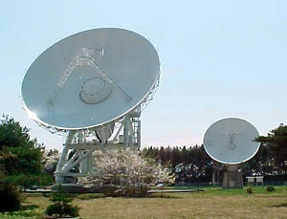
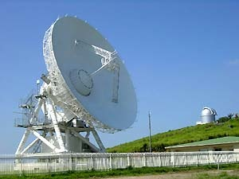
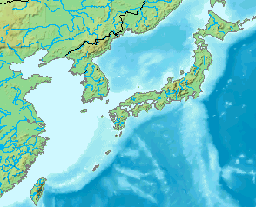
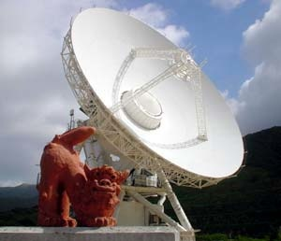
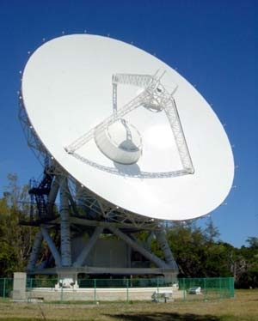
VERA
Mizusawa 20m (& 10m)
Mizusawa
Correlation Center at Mitaka/NAOJ
Iriki 20m
Seoul
Ulsan
KVN
Jeju
Iriki
VERA
Ishigaji-jima 20m
Ogasawara
Ishigaki
Ogasawara 20m
And, two years after Surcis et al.’s observation, we observed W75N with VERA.

Slide 6
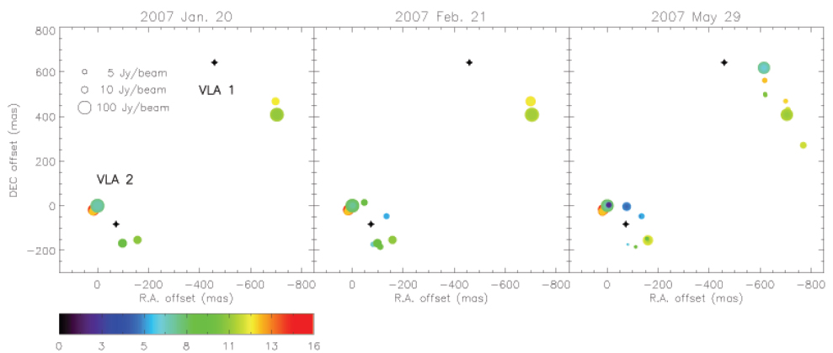
Distribution of H2O Masers in W75N -2007 (VERA)
Kim et al (2013)
We observed water masers three epochs of VLA 1 and VLA 2 regions in 2007 January, February and May.

Slide 7
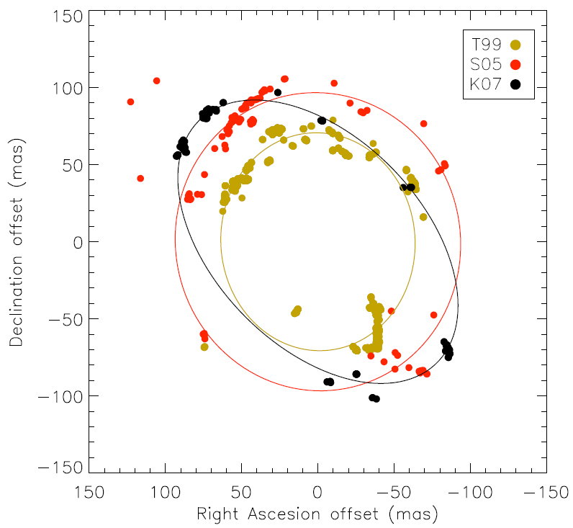
H2O Masers in VLA 2 Region: Elliptical Model Fit Expanding Shell
Ellipses | Epoch | a (mas) | b (mas) | b/a | PA (°)
T99 | 1999.3 | 71±1 | 64±1 | ~0.90 | 5±3
S05 | 2005.9 | 97±3 | 93±2 | ~0.96 | 15±45
K07 | 2007.2 | 111±1 | 68±1 | ~0.61 | 45±1
We compared ours to previous 1999 and 2005 observation.
To our surprise, the shell has become more eccentric, giving us a hint that the outflow has evolved from wind-like to more bipolar-like.

Slide 8
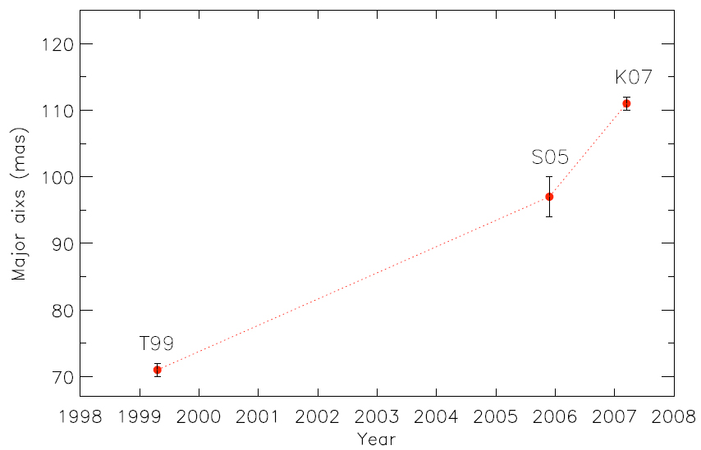
H2O Masers in VLA 2 Region: Elliptical Model Fit Expanding Shell
Ellipses | Epoch | Expansion Velocity
 |  | (mas /yr) | (km/s)
T99 | 1999.3
S05 | 2005.9 | T99−S05: 3.9 ± 0.8 | T99−S05: 37 ± 8
K07 | 2007.2 | S05−K07: 10.8 ± 3.1 | S05−K07: 102 ± 29
 |  | T99−K07: 5.1 ± 0.2 | T05−K07: 48 ± 2
Furthermore, based on the major axis, the expansion velocity of the shell is increased.
This means the shell has been accelerated !

Slide 9
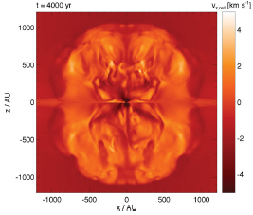
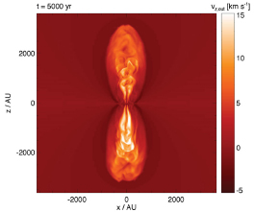
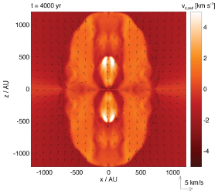
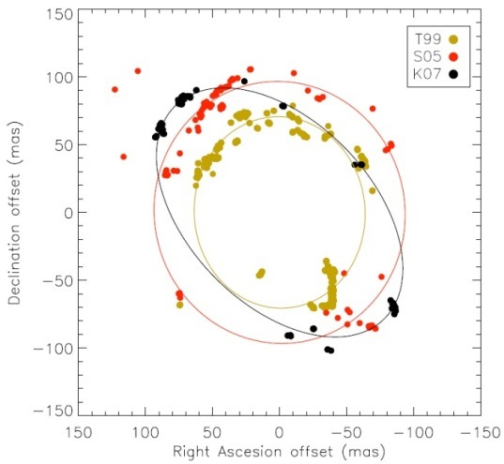
Comparison to New MHD Model (Seifried et al. 2012)
First, In the very early stage, poorly collimated sphere-like outflows are typical, with sub-Keplerian disks and strong magnetic fields.
Second, outflow collimation will quickly increase due to the development of well-collimated, fast jets coupled to the build-up of Keplerian disks with a few times weak magnetic fields.
[1]
[2]
Fast, jet-like signature
development of a inner, fast component
outer, slowly expanding component
Slow, wind-like slow expansion
[3]
[Kim et al. 2013]
Third, for models with a intermediate magnetic fields , there are outflows consisting of two distinct components:
an outer, slowly expanding component and
an inner, fast component, and the transition is continuous.
Their MHD results are consistent with our observational result, that is, in the very early stage of massive star formation, the less-collimated outflow would appear before the collimated outflow.

Slide 10
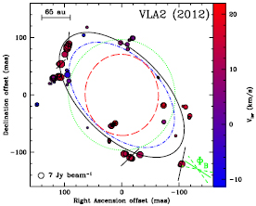
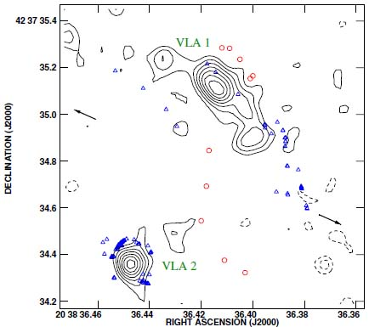
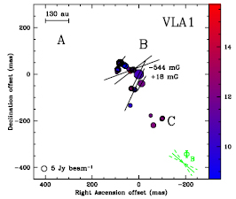
Polarization observation in W75N - 2012
Surcis et al (2014)
1999
2005
2007
2012
VLA1
orientation of magnetic field
(with errors)
measured with polarization
VLA2
1.3 cm continuum contour map:
water (blue) & OH maser(red).
[Torrelles et al. 1997]
linear polarization vector
In the VLBI observation in 2012, Surcis et al. found that:
The maser shell outflow is still expanding and elongated similar to 2007.
The magnetic field orientation has been changed to the new direction of the major axis, aligned with that in VLA1 along with the direction of the large-scale molecular outflow.

Slide 11
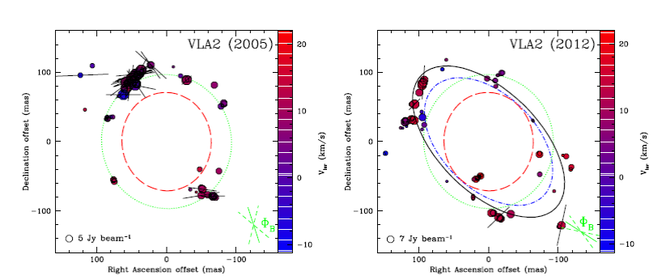
Polarization observation in W75N - 2005 vs. 2012
Surcis et al (2014)
The magnetic field in 2012 is one third of the magnetic field measured in 2005.
It is consistent observational results with the recent simulation of Seifried et al (2012).
we are seeing such a dramatic evolution in real time, for the first time.

Slide 12
Follow-up observations
First, To trace of morphology for water maser in VLA2,
Three time observations on April to May by using VERA in 2014 was carried out.
We have a observational plan by using VERA or KAVA in 2015.
Second, to monitoring of polarization for W75N,
EVN proposal has been accepted for the polarization mode over 6 years, 4 epochs spaced by 2 years. And, the 1st one was recently performed on June 17, 2014.

